Slide 1
Member Purchase & Refinance Survey Findings
Alexis McNutt Unis, Robert Schultz
October 2023

Slide 2
Background
Goals and methodology
Research Goals
Understand awareness, consideration, intent, and key factors that influence if a start with SoFi Mortgage and/or drop off in order to identify key messages and experience needs that increase conversion and reduce drop off.
What percent of registered users / members who took out a mortgage in the last year were aware of SoFi mortgage?
What percent considered us vs not?
Why did they select their lender? What factors had the most impact on their decision?
What is their preferred lender experience?
Methodology
Included key questions from Q2 2022 Mortgage value proposition survey
3 audiences were included,
Registered users (RUs)/members that had a start with SoFi mortgage within the past 12 months
RUs/members that had a start with PL or SLR AND have purchased a home within past 12 months
CSM Members that have purchased a home within the past 12 months
Audience was 97% members, 3% RUs survey response rate is very low for RUs, recommend separate survey of RUs to understand their perspective
Survey was live 10/07 - 10/26
Research plan and survey, Research Summary

Slide 3
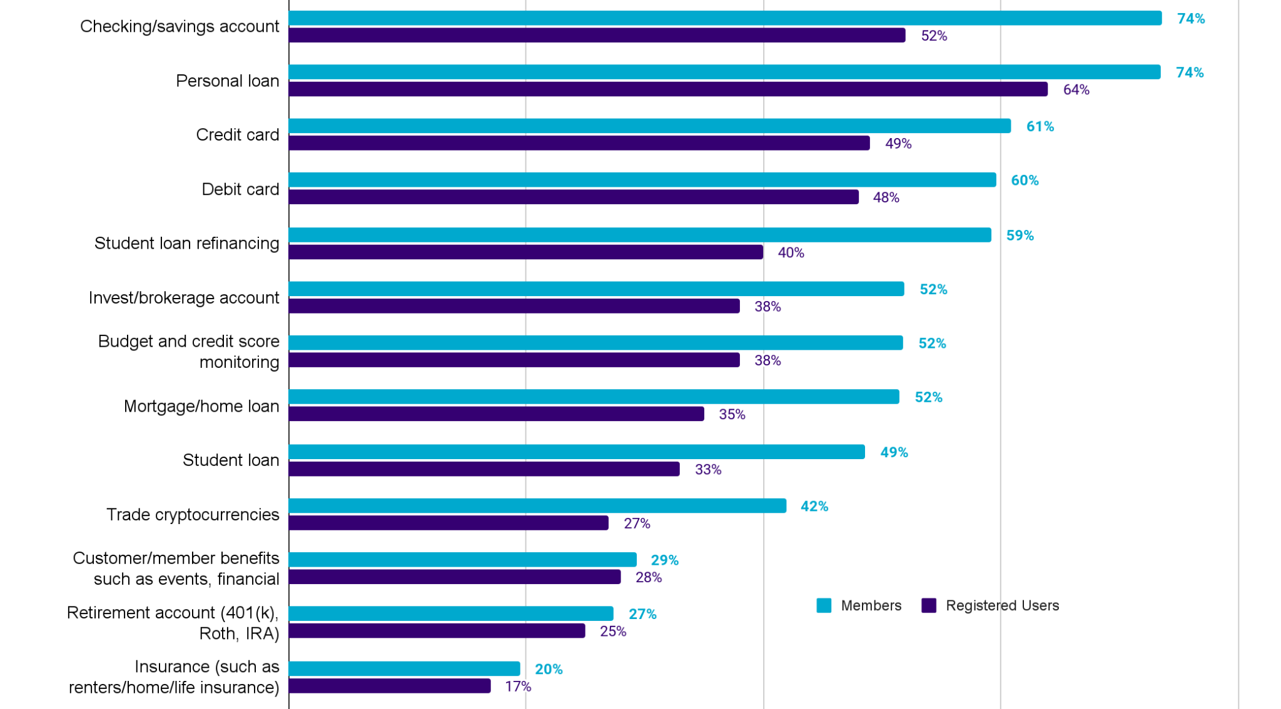
Awareness
Prior research shows SoFi Mortgage awareness is low and despite overall low sentiment, 60% are looking to buy within the next 3 years.
SoFi members are also more likely to be first-time home buyers than the national average, 54% of members are homeowners, in contrast to 65% of all Americans.
60% of members who are looking to purchase, are looking to do so in the next three years.
However, 64% of those members think now is a bad time to purchase a home.
52% of members are aware that Sofi offers mortgages versus 35% of registered users
TL;DR Member Survey, Census Quick Facts, Member Product Awareness Survey
To the best of your knowledge, which of the following products or services does SoFi currently offer? (Select all that apply). Member =4,240, RU =226

Slide 4
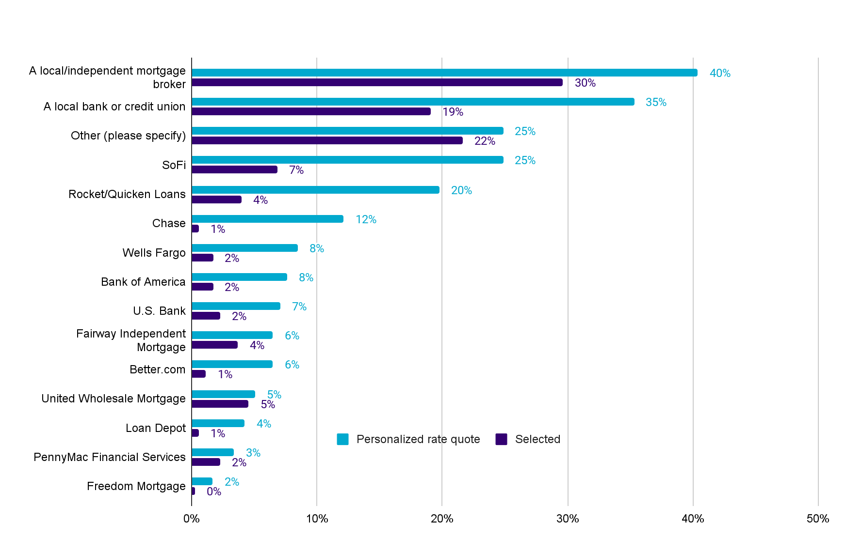
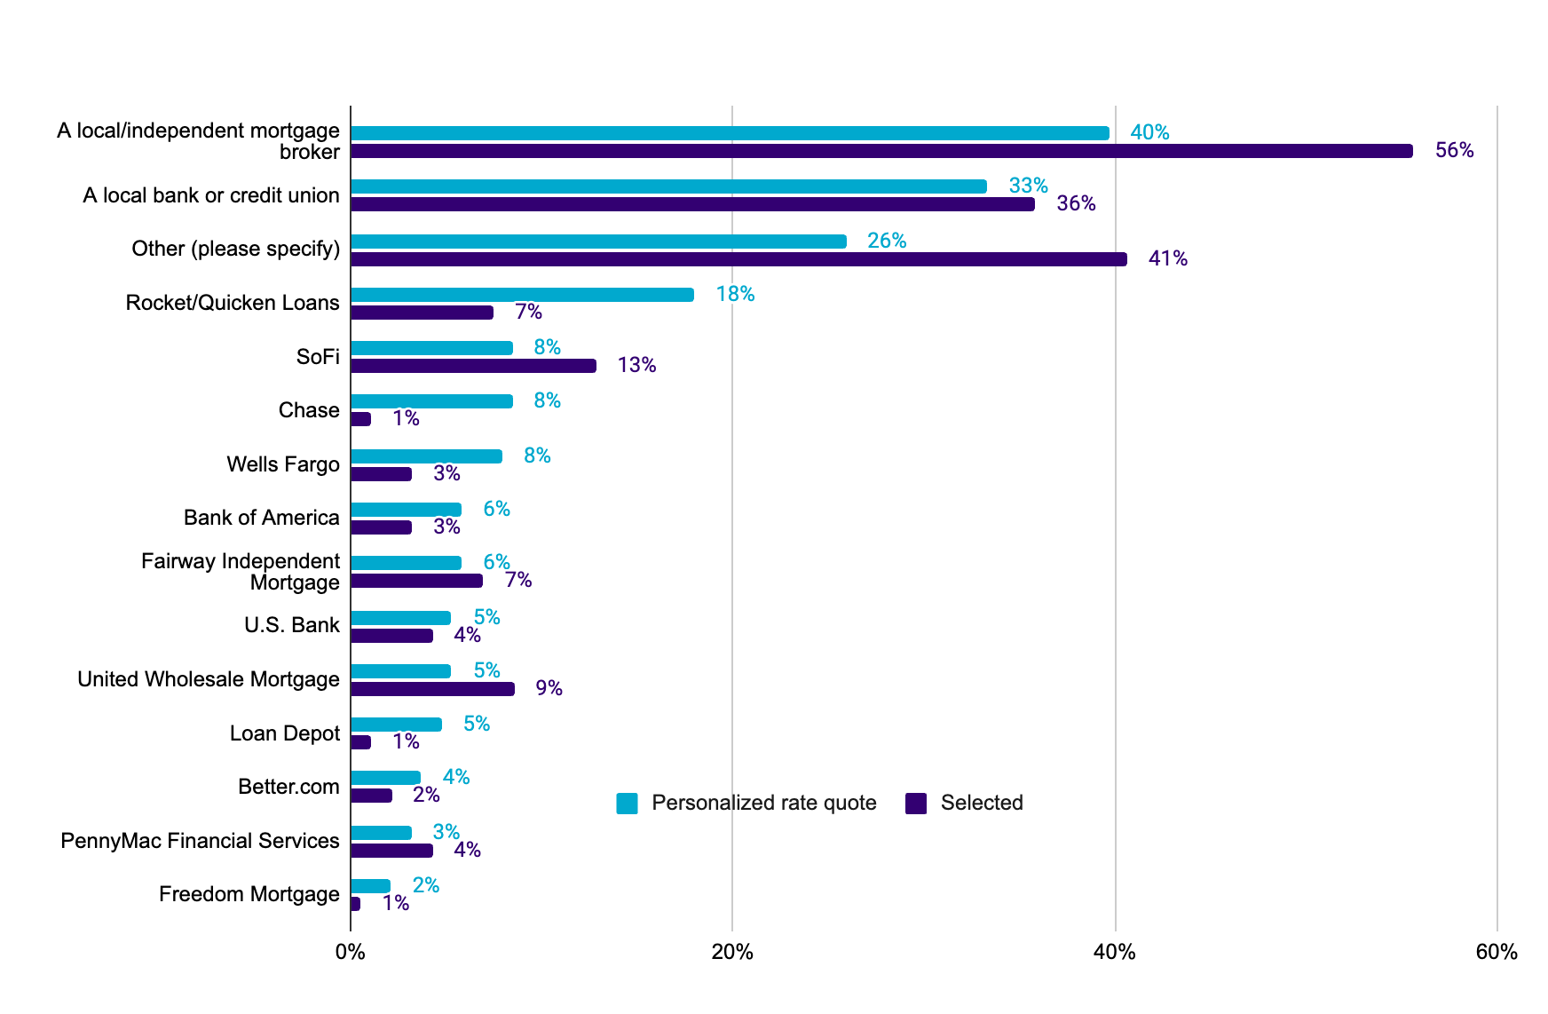
Consideration
SoFi loses home buyers to local/independent mortgage brokers, local credit unions/banks, and a ‘longtail’ of mortgage shops.
JUST PL/SL starts and CSM members Which of the following lenders did you get a personalized rate quote from? Please select all that apply. n=189 Which of the following lenders did you end up using for your mortgage? n=187
While ‘online’ lenders and other known brands may be part of rate shopping, generally brokers and credit unions win
When it comes to checking rates, 40% check their rate with their local/independent mortgage broker, 25% with their local bank or credit union, and 20% with Rocket.
When it comes to selecting a lender, local mortgage brokers and banks/credit unions end up with half of all mortgages.
*Note this chart includes reaching out to HL starts, when including only CSM members and PL/SL starts, 8% of SoFi members check their rate with SoFi, 13% select SoFi
Which of the following lenders did you get a personalized rate quote from? Please select all that apply. n=354 Which of the following lenders did you end up using for your mortgage? n=351

Slide 5
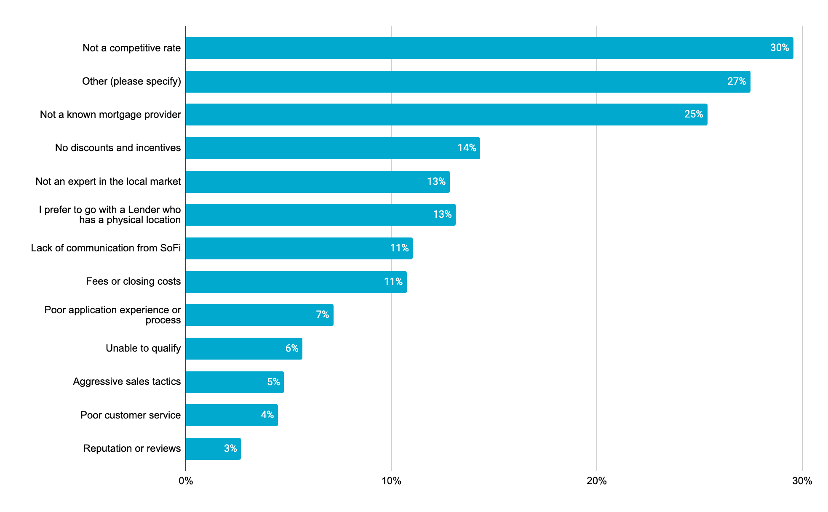
Selection
We continue to lose to low rates and more ‘known’ mortgage providers.
Those who did not fund with SoFi felt we did not provide a competitive rate (29%) nor are we a ‘known mortgage provider’ (25%) (n=335)
Those who did not fund with SoFi but did check their rate with SoFi wanted more ‘personalized discounts or incentives’, and more ‘personalized rate and experience’ for their particular mortgage situation as well as lower rates. (n=67)
Buyers also cited lack of awareness, builder incentives, lack of VA and FHA loan options, and poor communication and service as reasons for not funding with SoFi.
*Note for ‘other’ 8% of all other write in’s specified not aware, with 3% not eligible, 3% no FHA/VA options, 3% builder incentives, and 2% local preference, 2% no communication or bad experience
Why did you not choose to fund a mortgage with SoFi? Select up to 3 options. n=335

Slide 6
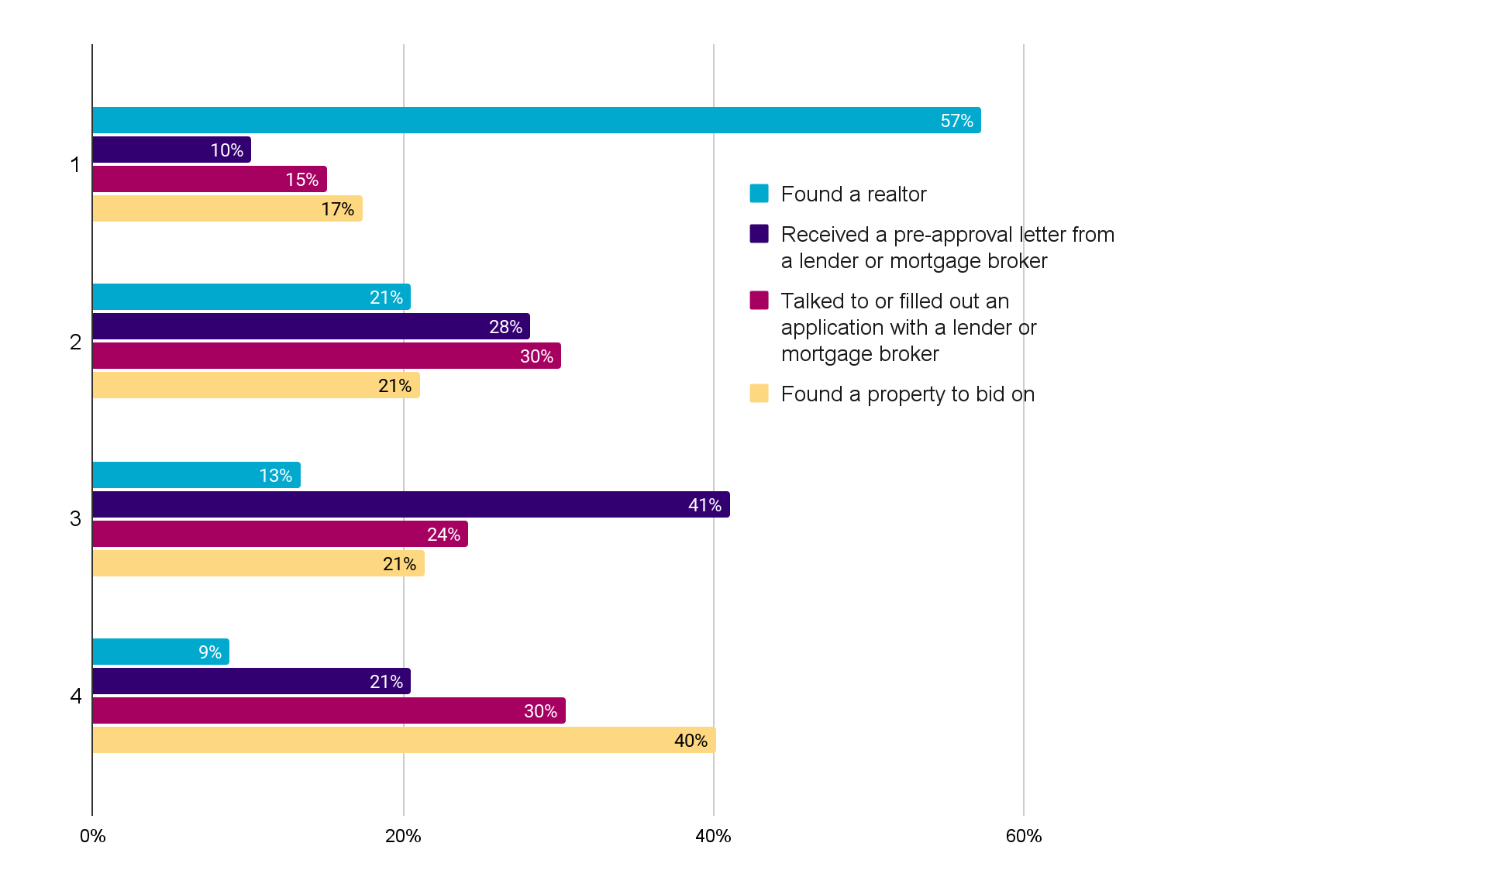
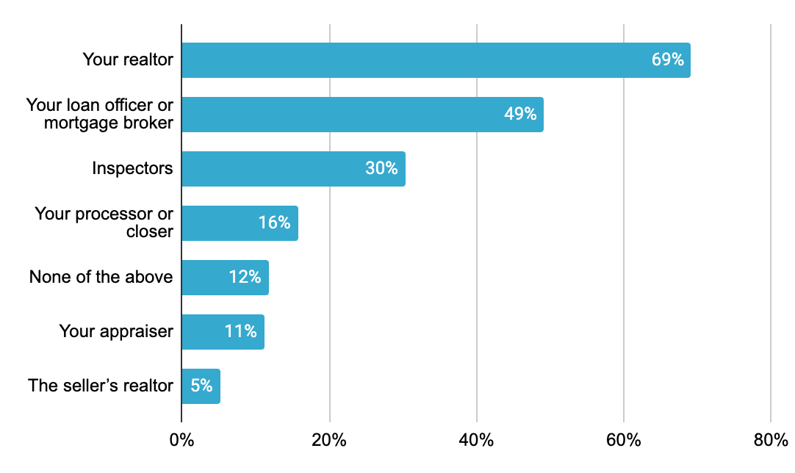
Selection
Realtors continue to be the initial step in the buying process, and 69% believe their realtor had their best interest in mind.
57% of home buyers found a realtor first, then engaged with a lender (compared to 25% lender first)
69% believe their realtor had their best interest in mind (compared to 49% of loan officers/brokers)
*Note there is not a clear consensus on lender engagement in steps 2 and 3, a pre-approval may come before or after an application. A self-serve pre-approval letter could be a point of differentiation for SoFi.
Which of the following people involved in your home buying process do you think had your best interest in mind? Please select all that apply. n=350
To the best you can recall, please place the following activities in the order you completed them. Please drag and drop each of the following in order of completion. n=351

Slide 7
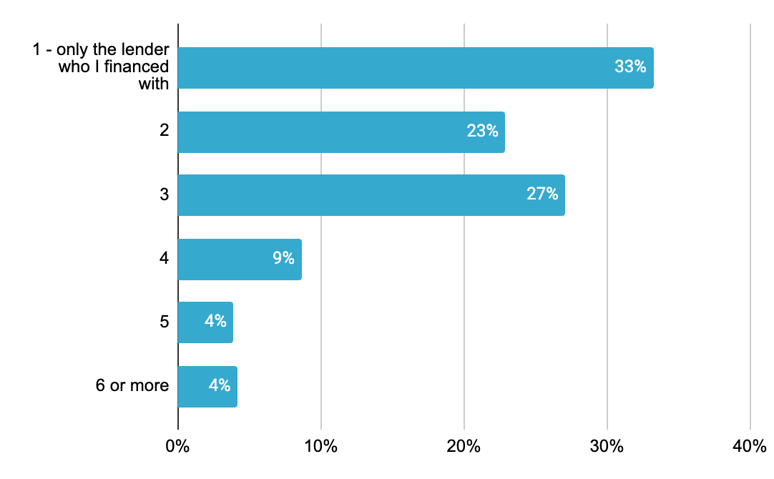
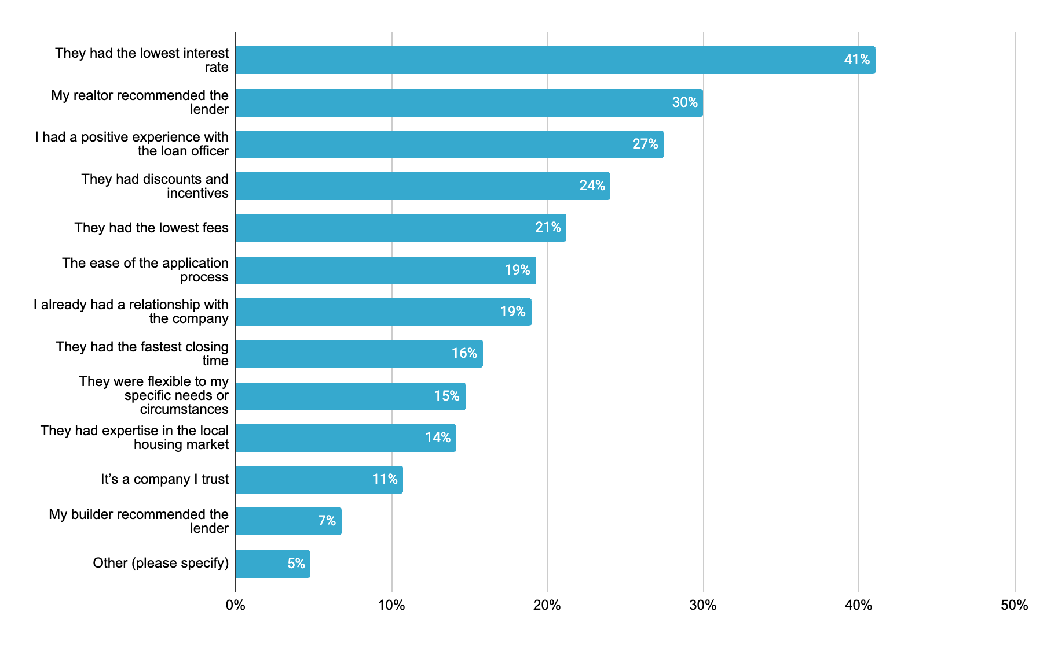
Selection
Rates and realtor recommendations are primary drivers in lender selection, but there is opportunity to capture buyers when they have a positive experience with a loan officer.
56% of home buyers checked their rates with two or less lenders (33% only one)
When looking to engage a lender, besides lowest rate, the most impactful factor in choosing a lender was a recommendation by their realtor
How many lenders total did you get a personalized rate quote from? n=358 Which of the following factors were the MOST impactful in your decision to select your lender? Select up to 3 options. n=353
Notes:
Voice over could be that people are willing to pay a little extra for a positive experience - positive experience with the loan officer ranks higher than "discounts..." or lowest fees when selecting a lender.

Slide 8
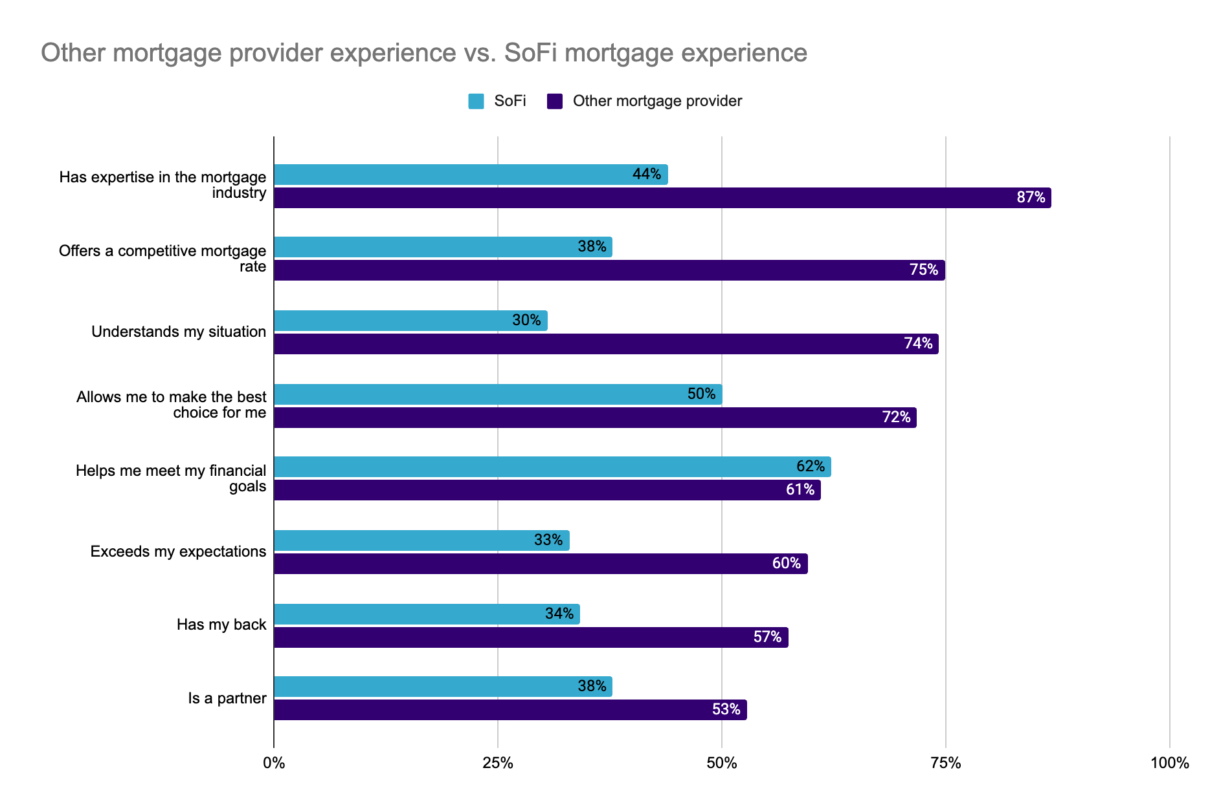
Experience
When comparing the experiences of other mortgage lenders to SoFi, SoFi scores well below others in mortgage specific areas but does exceed in GYMR.
For those who checked their rate with SoFi and/or funded with SoFi, SoFi scored well below selected mortgage providers on ‘has mortgage expertise’ and ‘offers competitive rates’ but did exceed in areas around GYMR like ‘helps me meet my financial goals’.
Members strongly agree or agree that their selected mortgage lenders have expertise, competitive rates, and understand their situation
Mortgage
GYMR
How much do you agree or disagree the following statements describe your experience SoFi. n=82
How much do you agree or disagree the following statements describe your experience with your recent mortgage provider. n=326
Relationship

Slide 9
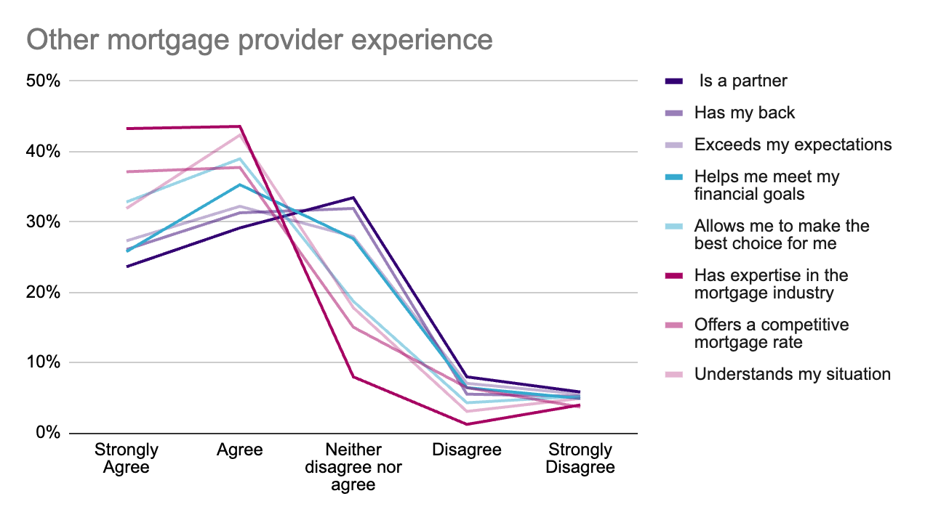
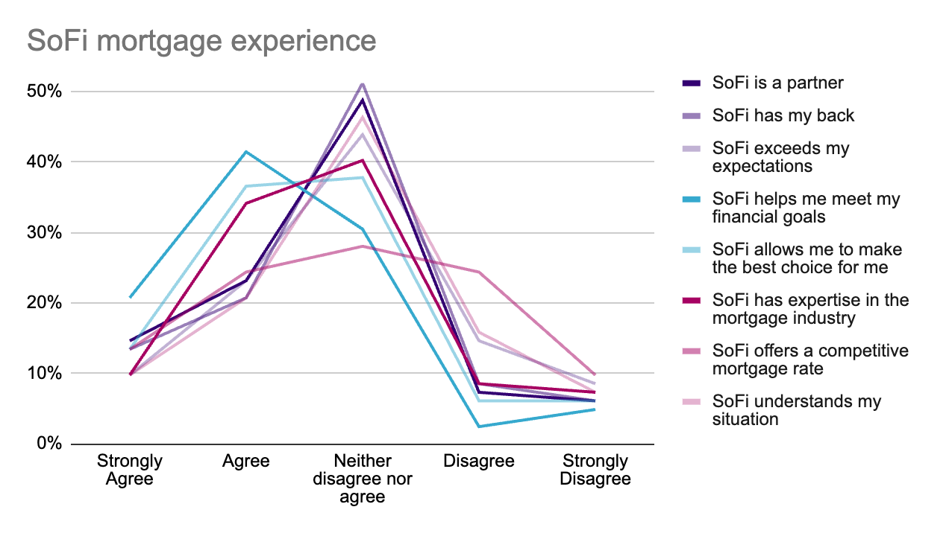
Experience
When comparing the experiences of other mortgage lenders to SoFi, SoFi scores well below others in mortgage specific areas but does exceed in GYMR.
Other mortgage providers exceed in mortgage specifics like expertise, rate, and understanding my situation but lag on being seen as a partner or having the buyer’s s back
SoFi has overall high percent of neutrality toward the mortgage experience, there is a lot potential for improvement
How much do you agree or disagree the following statements describe your experience SoFi. n=82
How much do you agree or disagree the following statements describe your experience with your recent mortgage provider. n=326

Slide 10
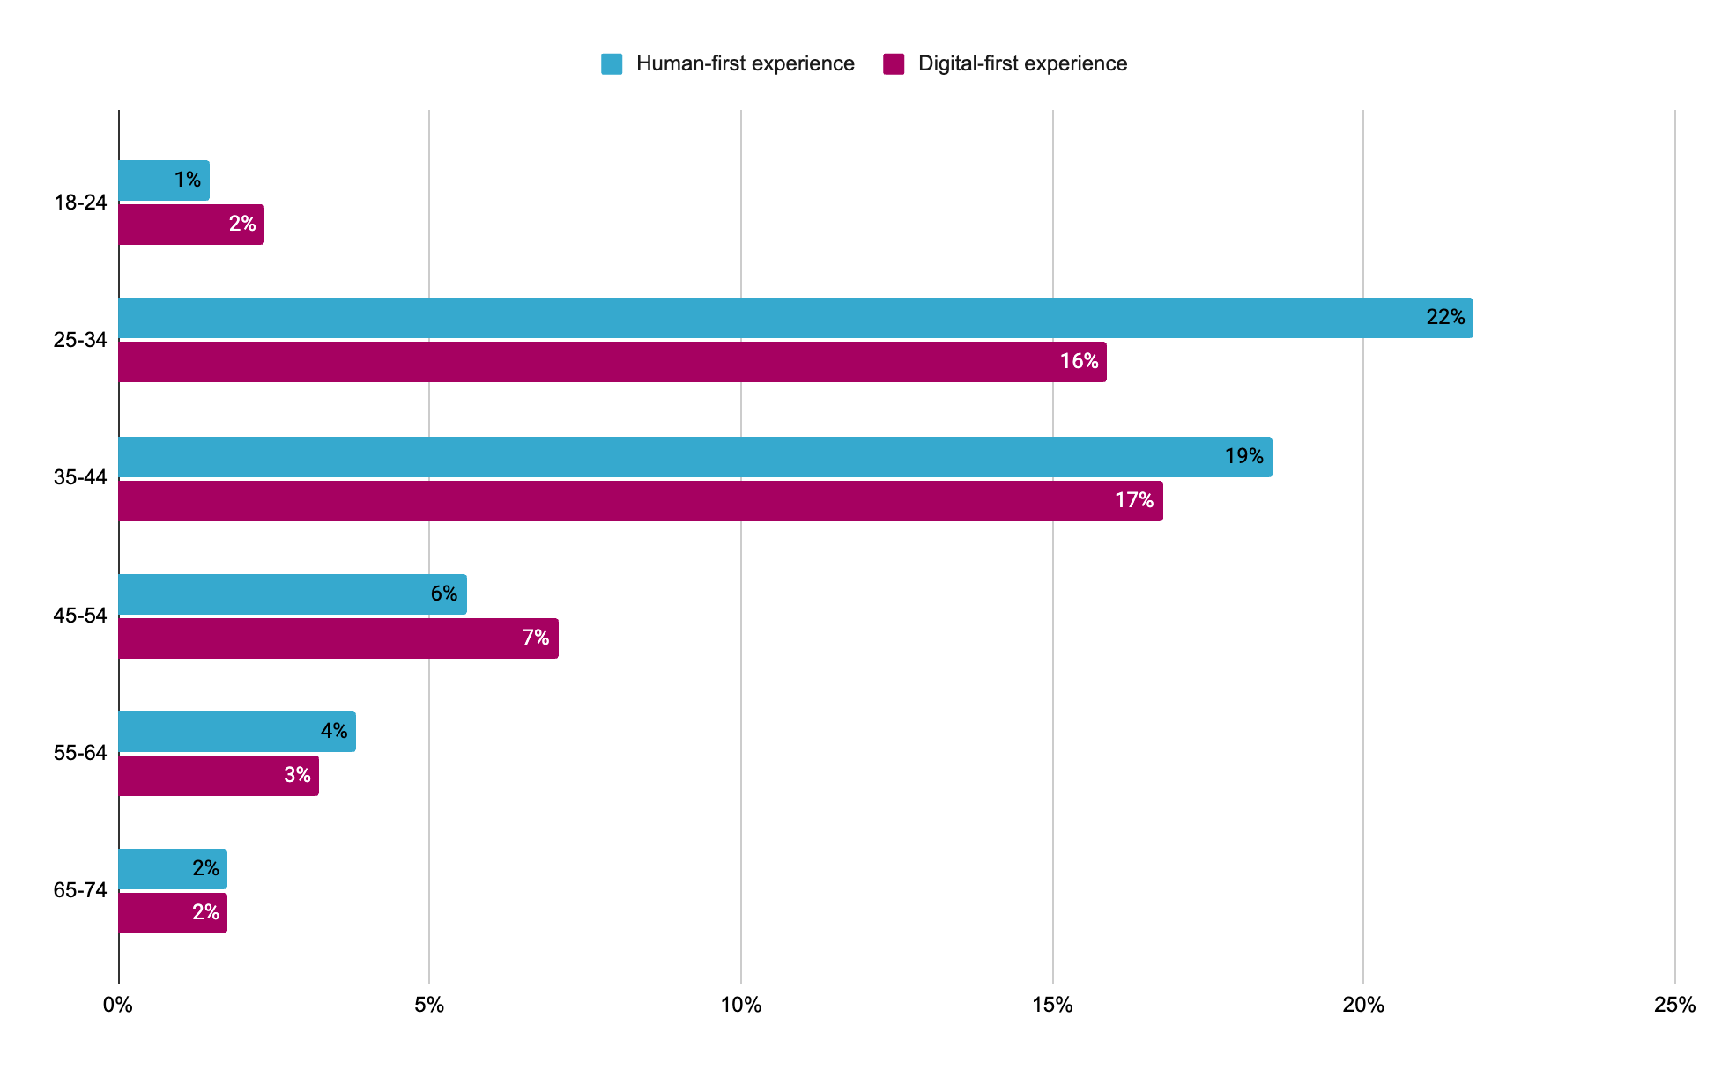
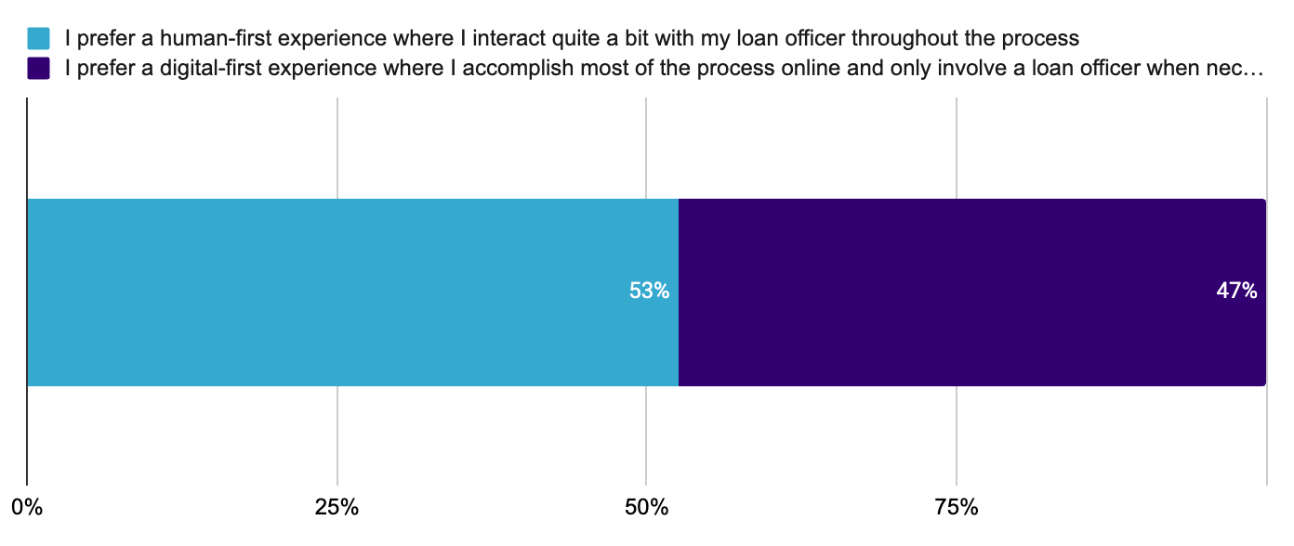
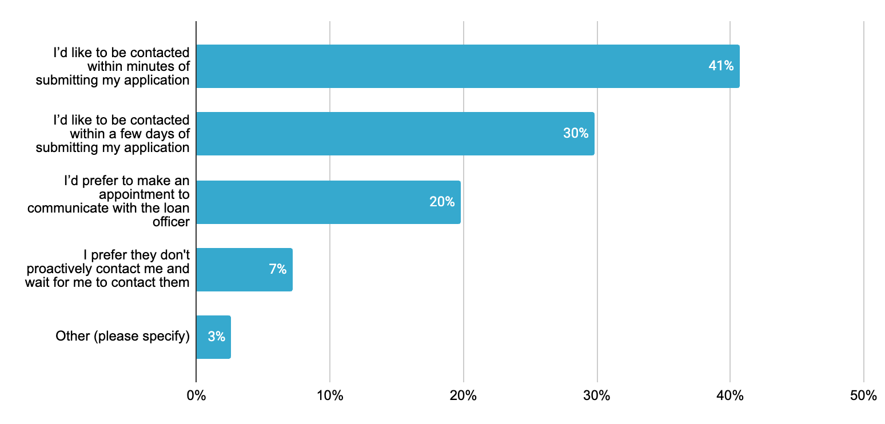
Experience
Meeting members where they are at either digital or human, fast or at their own pace is preferred.
Age is not a strong indicator of human vs digital-first preference, directionally it seems that younger borrowers prefer a more human-first experience, this could be due to likelihood of being a first-time homebuyer
Purchasers are split 50/50 between wanting a human-first experience and preferring a digital-first experience in the mortgage process.
40% want to be contacted within minutes of submitting their mortgage application and 31% would like to be contacted within a few days of submitting their application.
When it comes to the process of getting a mortgage, which of the following best describes your preferred experience? n=350 When would you prefer to first hear from your loan officer? n=349
When it comes to the process of getting a mortgage, which of the following best describes your preferred experience? by What is your age? n=340

Slide 11
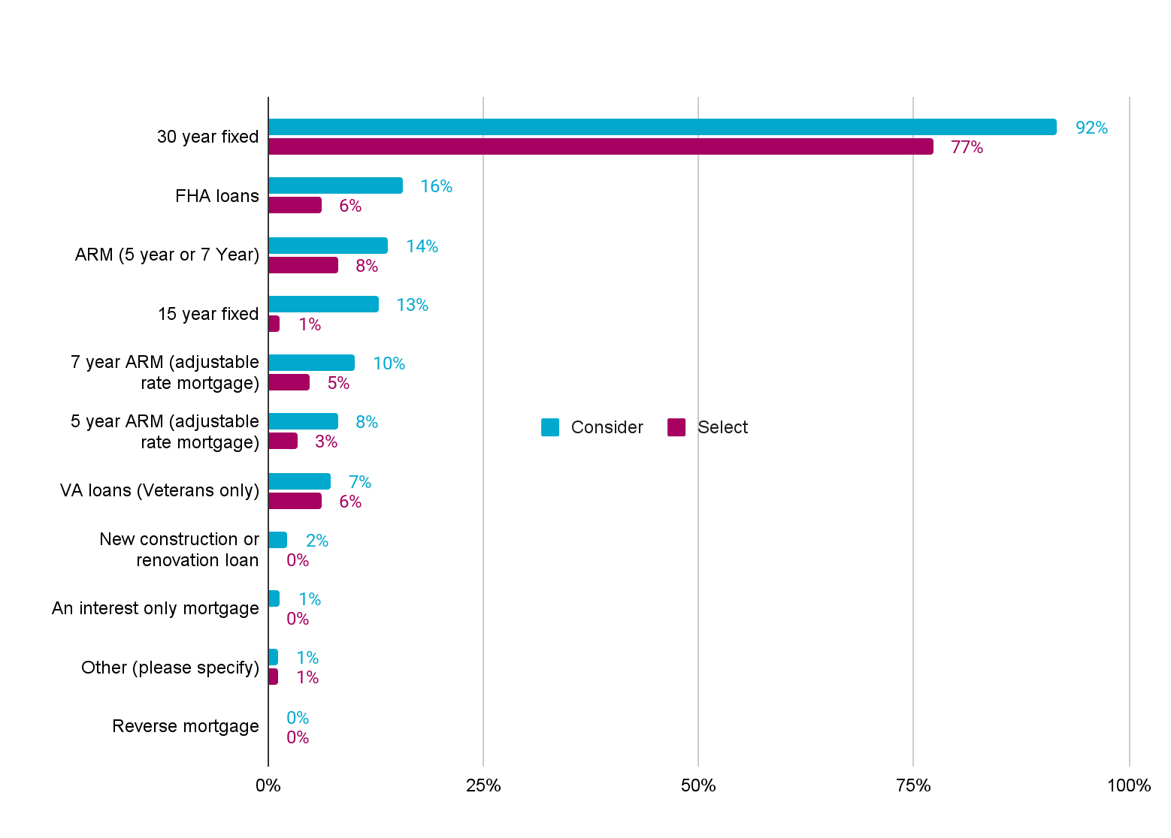
Loan consideration and selection
30 year fixed remains the most considered and selected loan type, ARMs (5&7 year), FHA and VA loans are the next most selected.
What types of mortgages did you consider? Please select all that apply. n=360
What mortgage did you select? n=360

Slide 12
Appendix

Slide 13
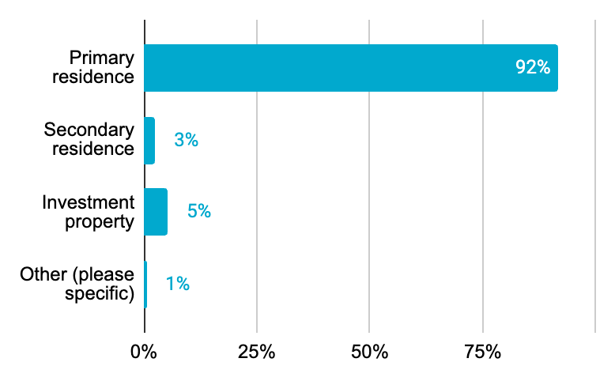
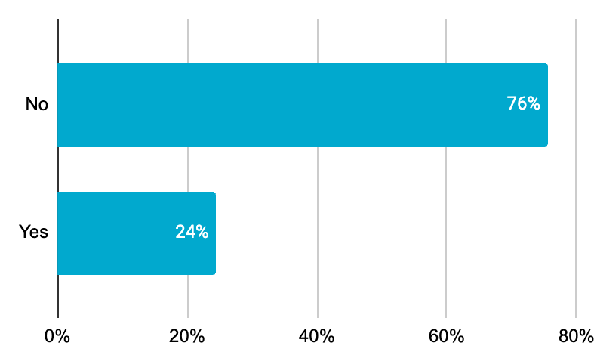
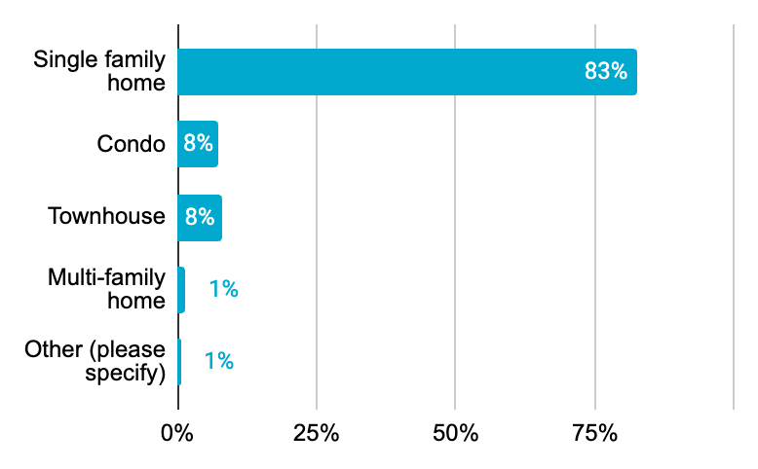
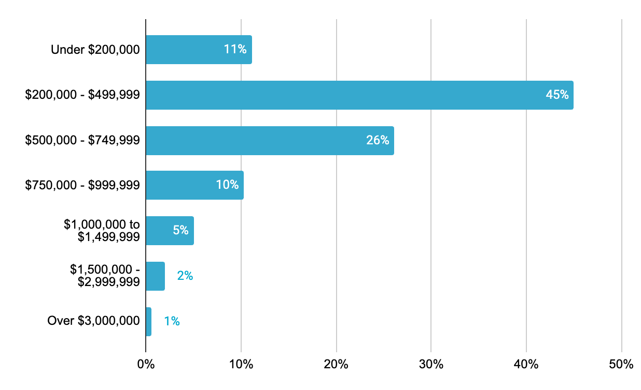
Purchaser profile
Demographics
91% of all purchases were for primary residence
24% of all purchases were new builds or constructions
72% of recent home buyers were between the ages of 25 and 44
68% of new home buyers are married
82% of new buyers report making over 100k
80% of all buyers report over a 720 credit score
82% of all purchases were single family homes
81% of recent home sales were $200k to a million
Was the home you recently purchased a....? n=360
Was the home you recently purchased a new build/construction? n=360
What type of property did you recently purchase? n=360
What was the total purchase price of the home you most recently purchased? n=360

Slide 14
Refi summary
16% refinanced in the past 12 months, majority of refis are cash out
*Please note our sample size for refinance experience was small (n =68) so use these results directionally.
70% of home refinances had a assessed value of under 500k.
Cash out refinance is the most common refinance considered and selected.
89% of those who refinanced got quotes from two or less lenders.
41% said a positive experience with a loan officer was impactful in their decision to choose their lender.
41% choose a lender because they already had a relationship with the company.
41% did not choose to refinance with SoFi because they were unaware SoFi offered mortgage refinancing.

Slide 15
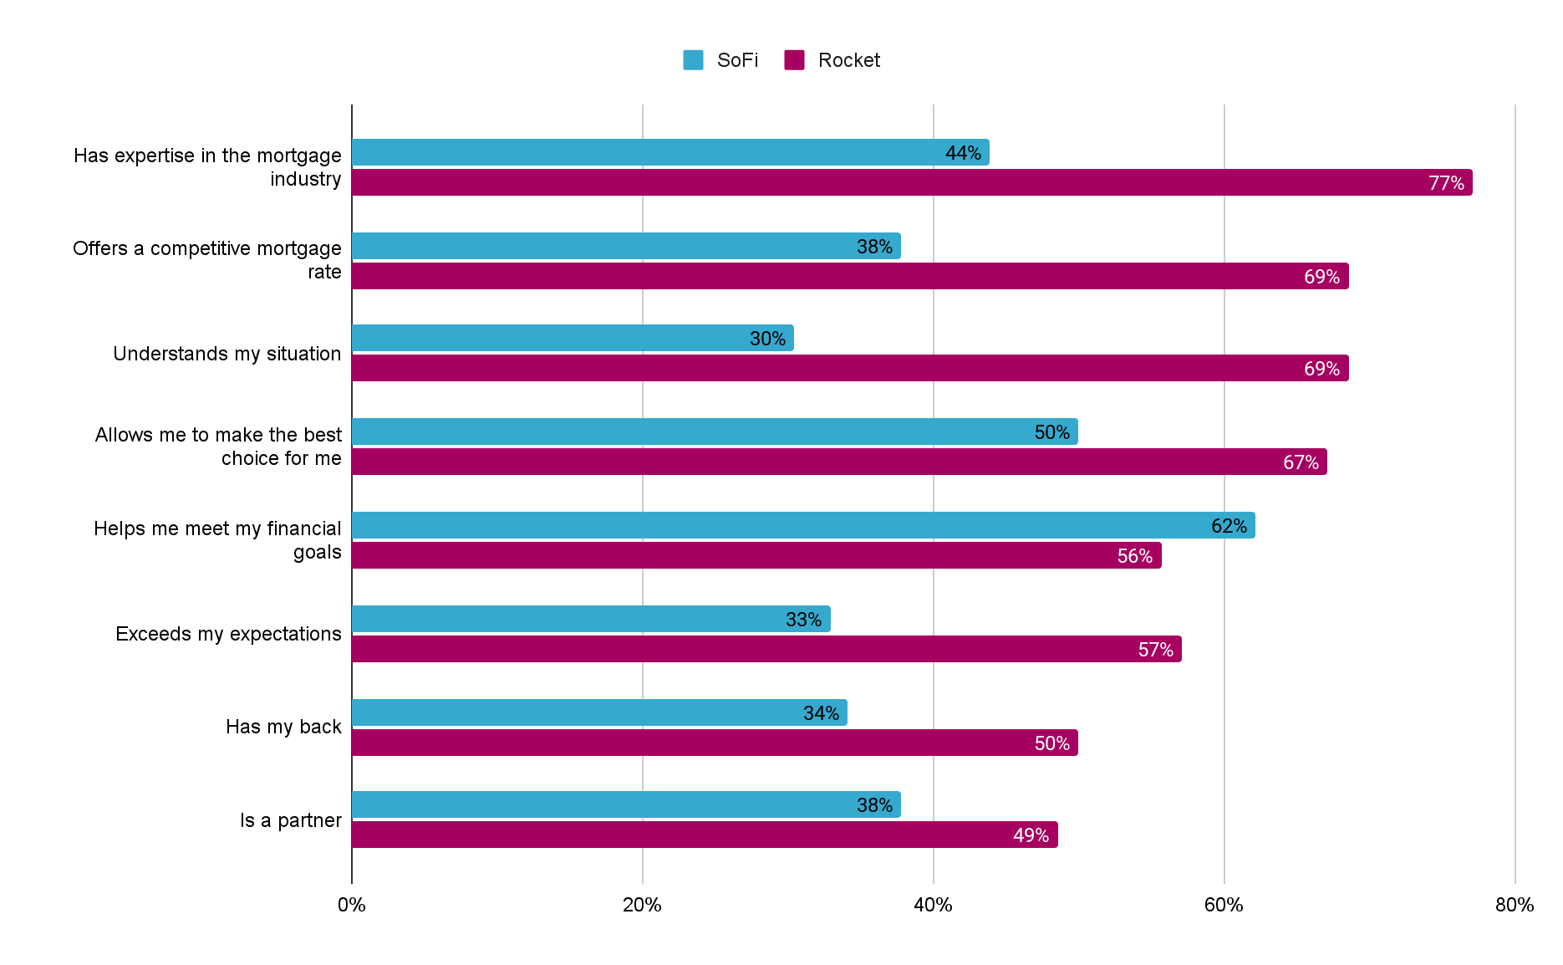
SoFi vs Rocket experience
While still lagging, SoFi scores closer to Rocket in mortgage specific and relationship categories.
*Sample size for SoFi vs. Rocket experience was small (n=82 SoFi and n=70 Rocket) so use these results directionally.
SoFi vs Other providers
SoFi vs Rocket
Mortgage
GYMR
Relationship
How much do you agree or disagree the following statements describe your experience SoFi. n=82
How much do you agree or disagree the following statements describe your experience with your recent mortgage provider. n=326 How much do you agree or disagree the following statements describe your experience with your recent mortgage provider. n=70 [only those who got a rate quote and/or selected Rocket for their mortgage]

Slide 16
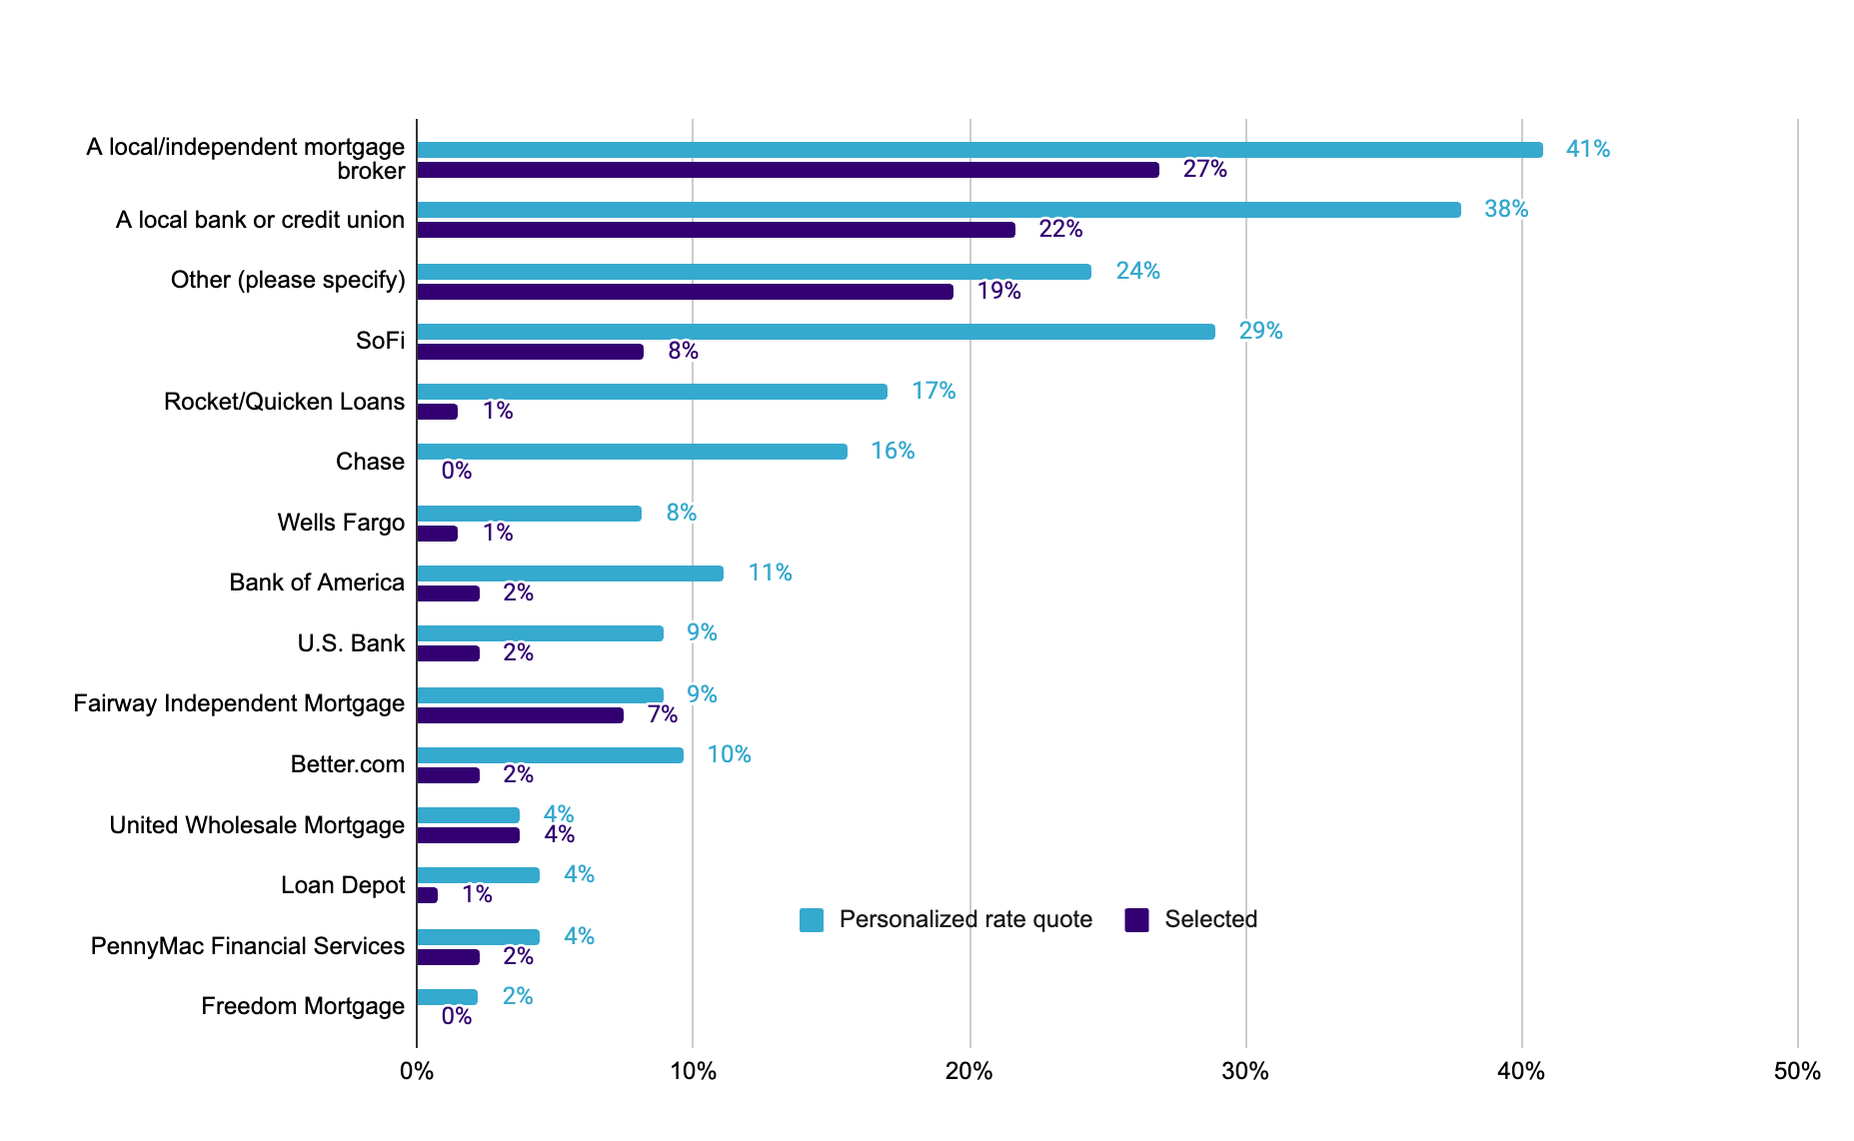
Pre-approval lender consideration and selection
For those that prioritize a pre-approval, lender consideration / selection remains similar to all buyers
All respondents
Those that get a pre-approval as step 1 or 2
*Note Better pops a bit in ‘consideration’ for those that prioritize a preapproval but all other percents are relatively the same.
Which of the following lenders did you get a personalized rate quote from? Please select all that apply. n=354
Which of the following lenders did you end up using for your mortgage? n=351
Which of the following lenders did you get a personalized rate quote from? Please select all that apply. [who received a pre-approval letter from a lender or mortgage broker as step 1 or 2] n=135
Which of the following lenders did you end up using for your mortgage? [who received a pre-approval letter from a lender or mortgage broker as step 1 or 2] n=134

